Slide 1
St. Louis Central Corridor West Building Permits
Monthly Report: May 2021

Slide 2
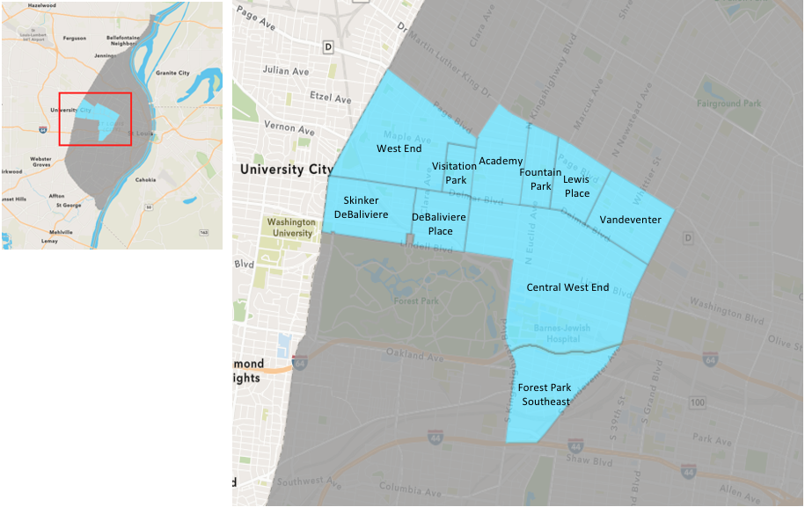
St. Louis Neighborhood Spatial Reference

Slide 3
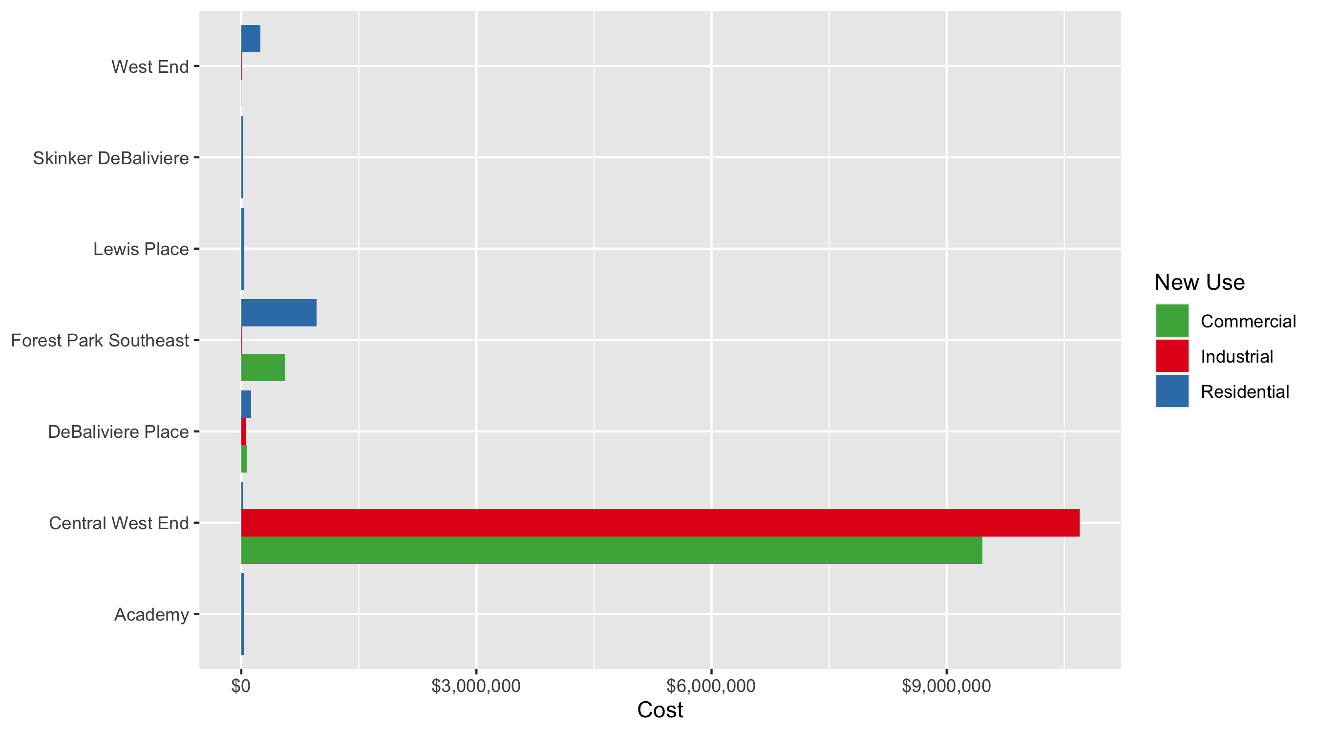
Neighborhood Summary: Average Building Permit Cost

Slide 4
Neighborhood Summary
May 2021 | May 2021 | May 2021 | May 2021
Neighborhood | Average Cost | # of Permits | Total Value of Permits
Academy | $31,475 | 2 | $62,950
Central West End | $4,834,208 | 38 | $183,699,921
DeBaliviere Place | $95,845 | 6 | $575,069
Forest Park Southeast | $816,140 | 15 | $12,242,095
Fountain Park | $0 | 0 | $0
Lewis Place | $37,143 | 1 | $37,143
Skinker DeBaliviere | $18,202 | 13 | $236,627
Vandeventer | $0 | 0 | $0
Visitation Park | $0 | 0 | $0
West End | $177,200 | 14 | $2,480,795
Last 6 Months | Last 6 Months | Last 6 Months | Last 6 Months
Neighborhood | Average Cost | # of Permits | Total Value of Permits
Academy | $57,455 | 16 | $919,275
Central West End | $1,473,985 | 212 | $312,484,828
DeBaliviere Place | $291,303 | 35 | $10,195,612
Forest Park Southeast | $854,213 | 77 | $65,774,400
Fountain Park | $323,057 | 9 | $2,907,517
Lewis Place | $12,521 | 10 | $125,206
Skinker DeBaliviere | $36,366 | 49 | $1,781,942
Vandeventer | $19,465 | 5 | $97,323
Visitation Park | $7,774 | 1 | $7,774
West End | $325,949 | 54 | $17,601,237

Slide 5
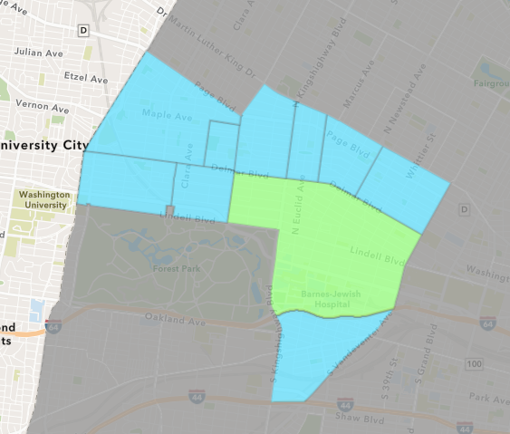
Central West End
May 2021 Neighborhood Cost Breakdown
Mean: $4,834,208
Median: $10,300
Range: $1,900 - $151,000,000

Slide 6
Central West End: Summary Notes
38 building permits in May 2021
90.00% change compared to May 2020 (20 total building permits)
$4,834,208: Average building permit cost in May 2021
12357.41% change compared to May 2020 ($38,806)
188 total building permits in 2021
27.89% change YTD compared to this time in 2020 (147 total building permits)
$1,469,851: YTD average building permit cost in 2021
307.23% change YTD compared to this time in 2020 ($360,941)

Slide 7
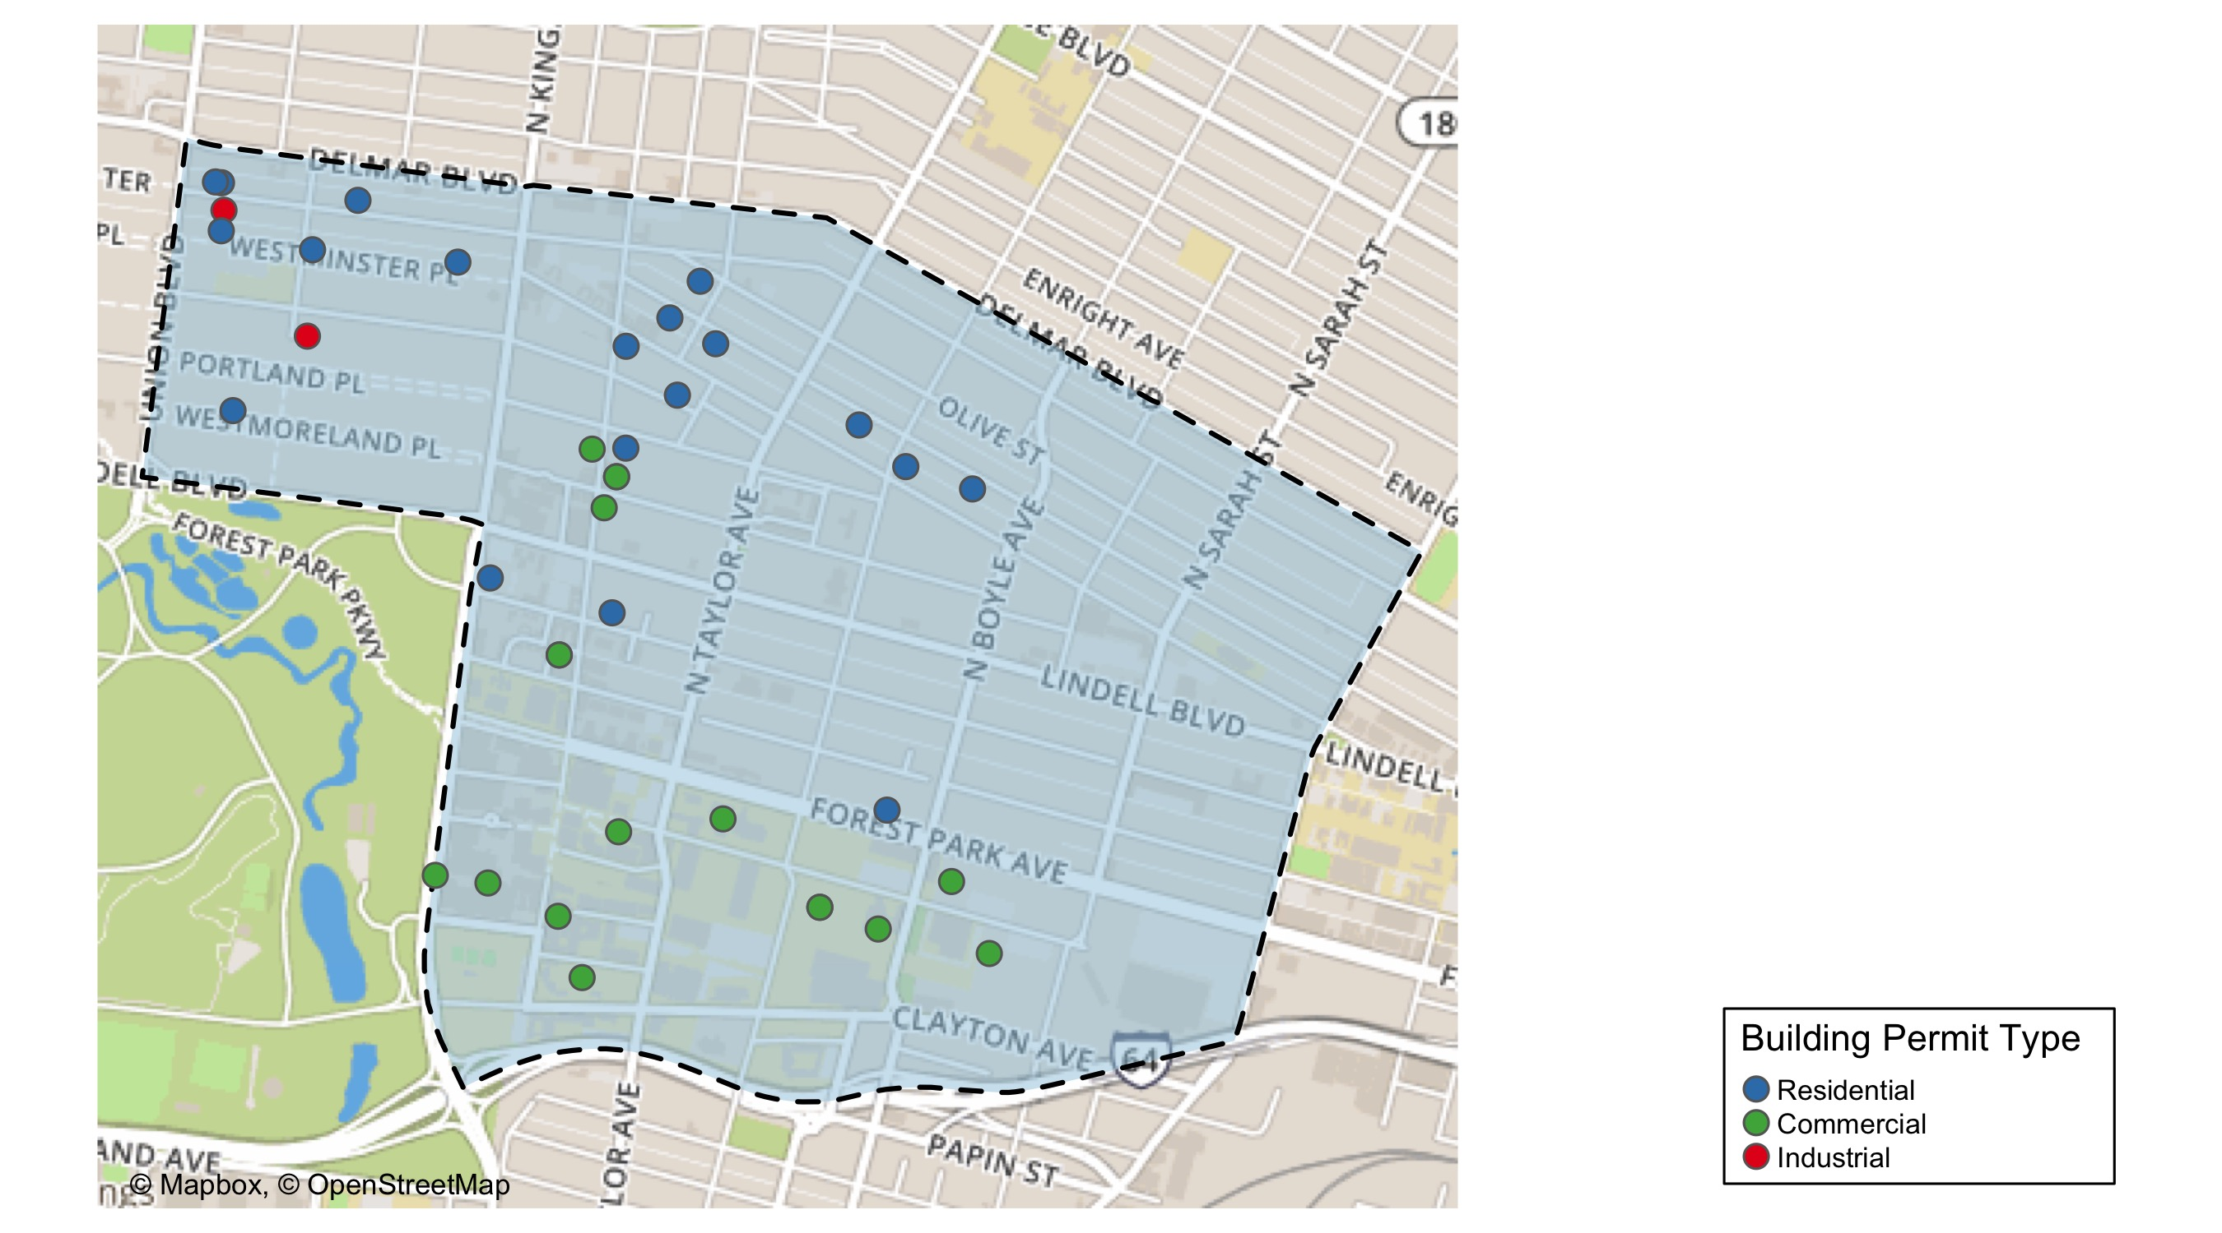
Central West End

Slide 8
Neighborhood Summary
May 2021 | May 2021 | May 2021 | May 2021
Permit Use | Average Cost | # of Permits | Total Value of Permits
Commercial | $9,455,658 | 16 | $151,290,523
Industrial | $10,694,558 | 3 | $32,083,673
Institutional | $0 | 0 | $0
Residential | $17,143 | 19 | $325,725
Last 6 Months | Last 6 Months | Last 6 Months | Last 6 Months
Permit Use | Average Cost | # of Permits | Total Value of Permits
Commercial | $2,803,689 | 85 | $238,313,574
Industrial | $2,519,224 | 13 | $32,749,907
Institutional | $0 | 0 | $0
Residential | $363,345 | 114 | $41,421,347

Slide 9
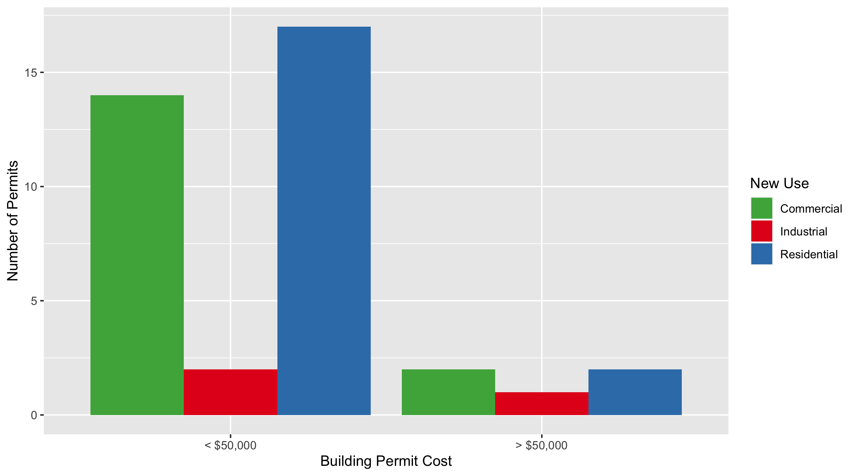
Central West End Permit Cost Breakdown

Slide 10
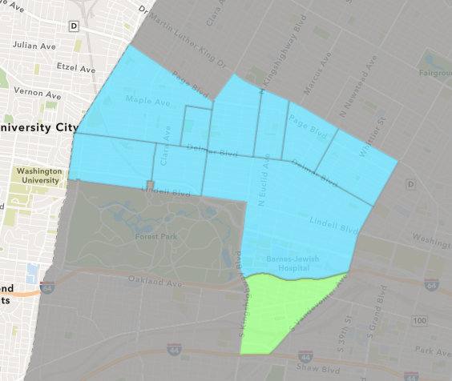
Forest Park Southeast
May 2021 Neighborhood Cost Breakdown
Mean: $816,140
Median: $120,000
Range: $250 - $3,821,501

Slide 11
Forest Park Southeast: Summary Notes
15 building permits in May 2021
50.00% change compared to May 2020 (10 total building permits)
$816,140: Average building permit cost in May 2021
20.34% change compared to May 2020 ($678,170)
69 total building permits in 2021
50.00% change YTD compared to this time in 2020 (46 total building permits)
$829,549: YTD average building permit cost in 2021
185.47% change YTD compared to this time in 2020 ($290,591)

Slide 12
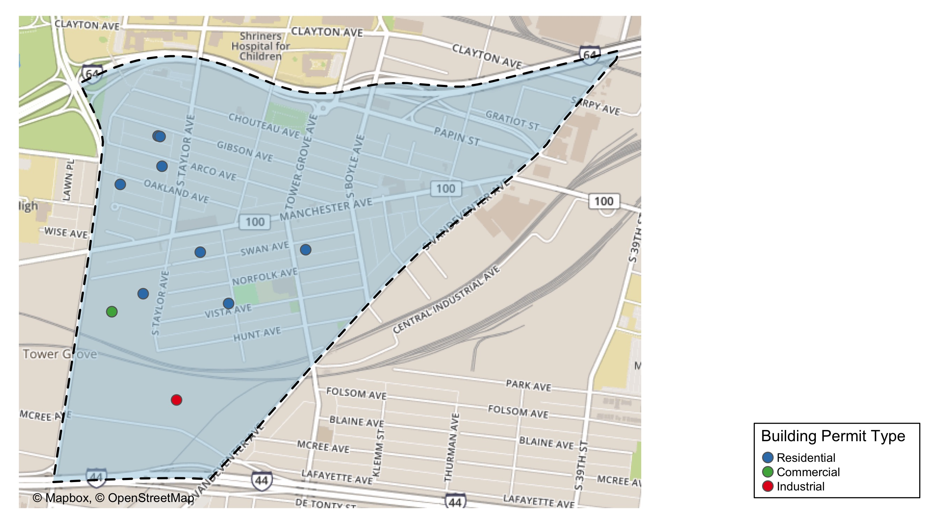
Forest Park Southeast

Slide 13
Neighborhood Summary
May 2021 | May 2021 | May 2021 | May 2021
Permit Use | Average Cost | # of Permits | Total Value of Permits
Commercial | $558,461 | 3 | $1,675,382
Industrial | $15,000 | 1 | $15,000
Institutional | $0 | 0 | $0
Residential | $959,247 | 11 | $10,551,713
Last 6 Months | Last 6 Months | Last 6 Months | Last 6 Months
Permit Use | Average Cost | # of Permits | Total Value of Permits
Commercial | $582,269 | 20 | $11,645,385
Industrial | $15,975 | 4 | $63,900
Institutional | $0 | 0 | $0
Residential | $1,020,097 | 53 | $54,065,115

Slide 14
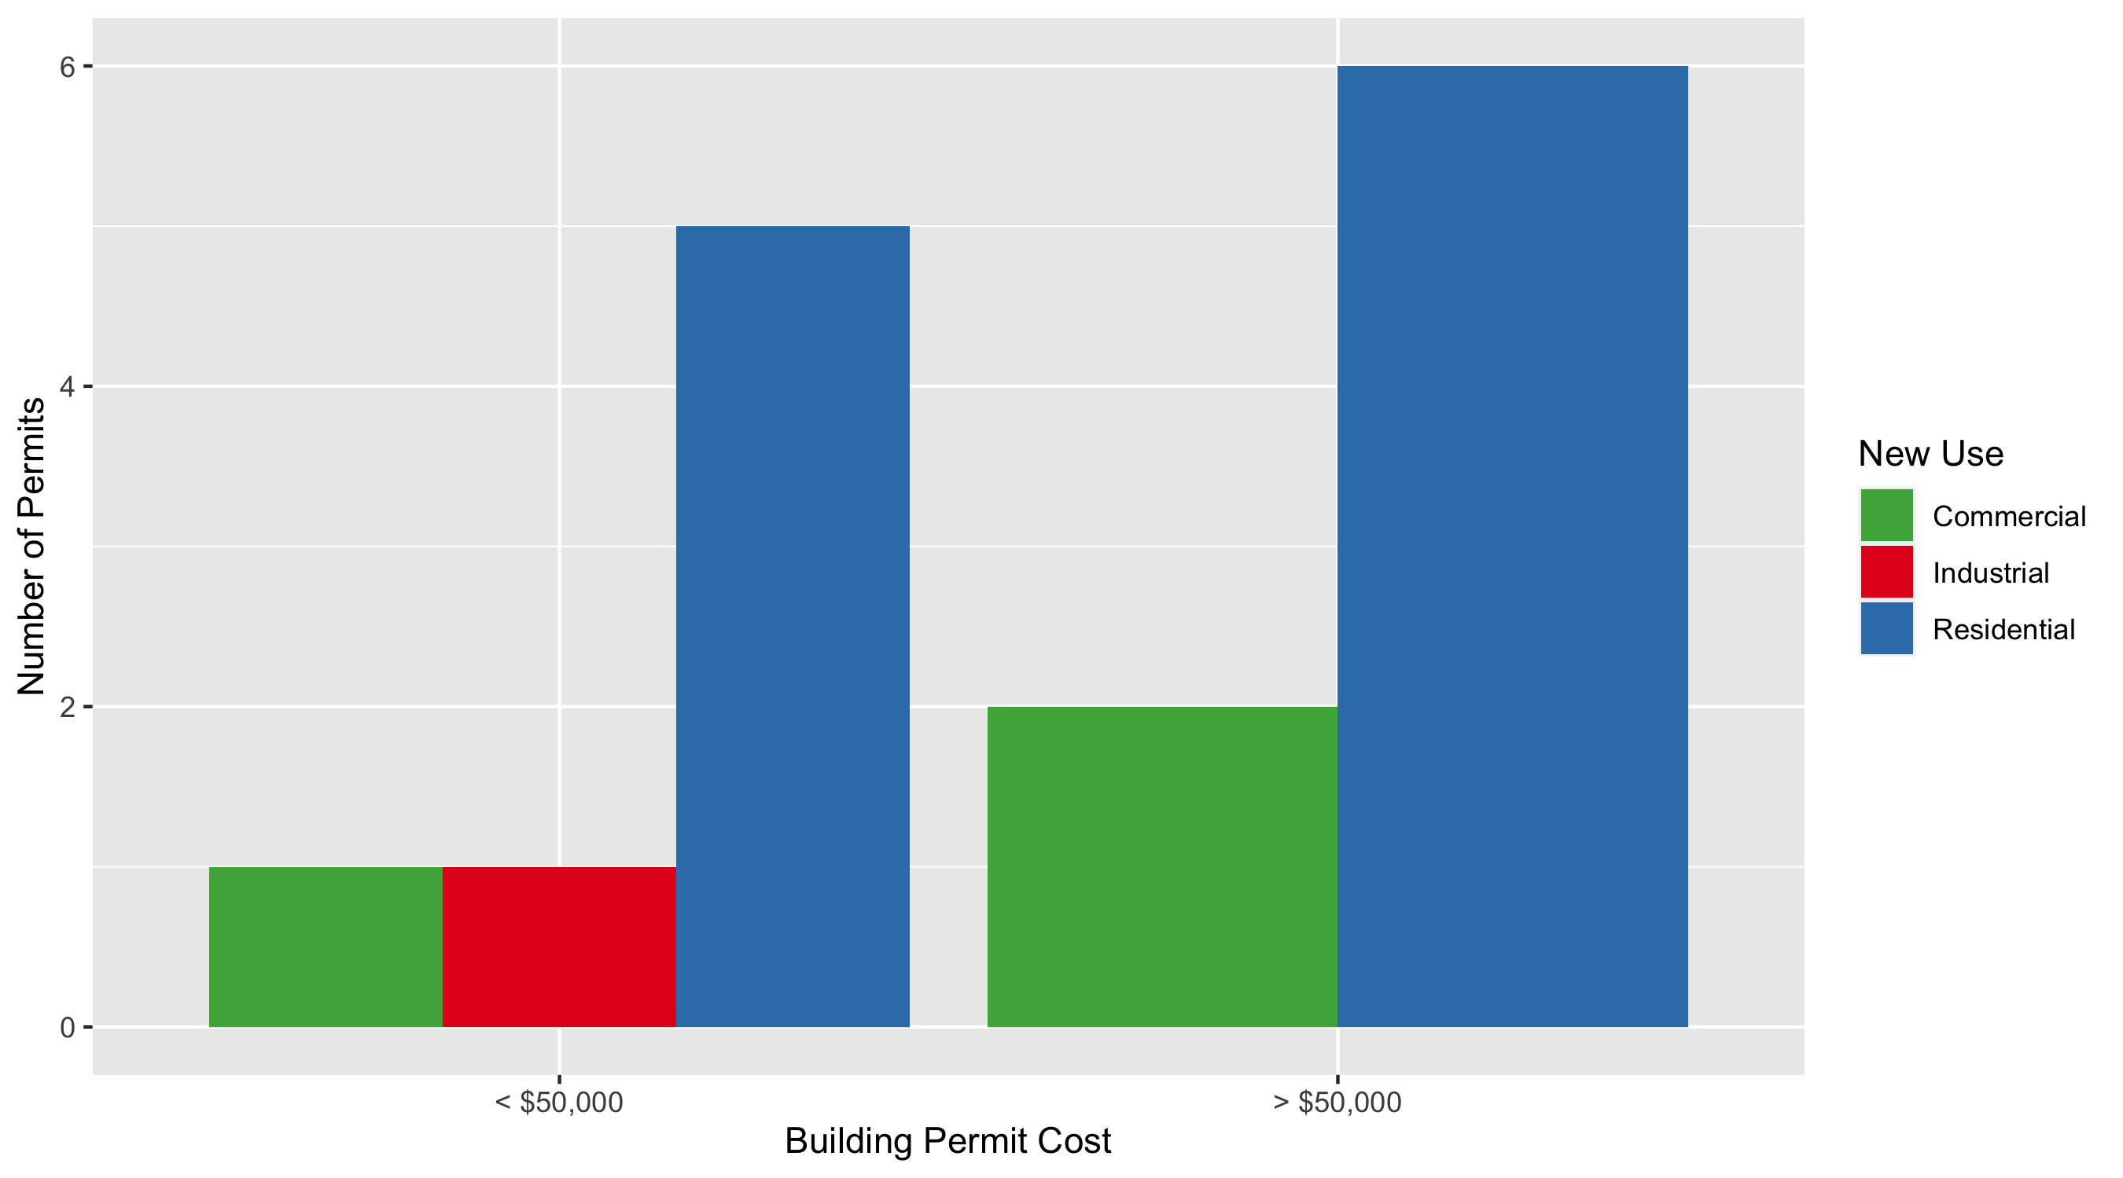
Forest Park Southeast Permit Cost Breakdown

Slide 15
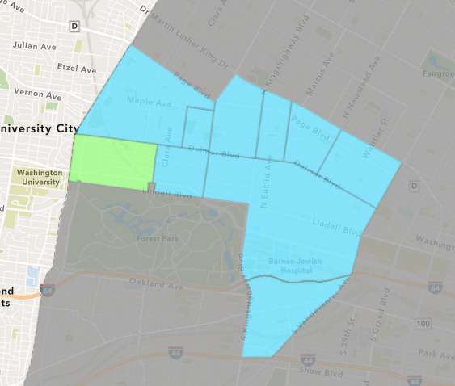
Skinker DeBaliviere
May 2021 Neighborhood Cost Breakdown
Mean: $18,202
Median: $14,669
Range: $400 - $80,000

Slide 16
Skinker DeBaliviere: Summary Notes
13 building permits in May 2021
62.50% change compared to May 2020 (8 total building permits)
$18,202: Average building permit cost in May 2021
-40.32% change compared to May 2020 ($30,500)
41 total building permits in 2021
-18.00% change YTD compared to this time in 2020 (50 total building permits)
$31,521: YTD average building permit cost in 2021
41.65% change YTD compared to this time in 2020 ($22,253)

Slide 17
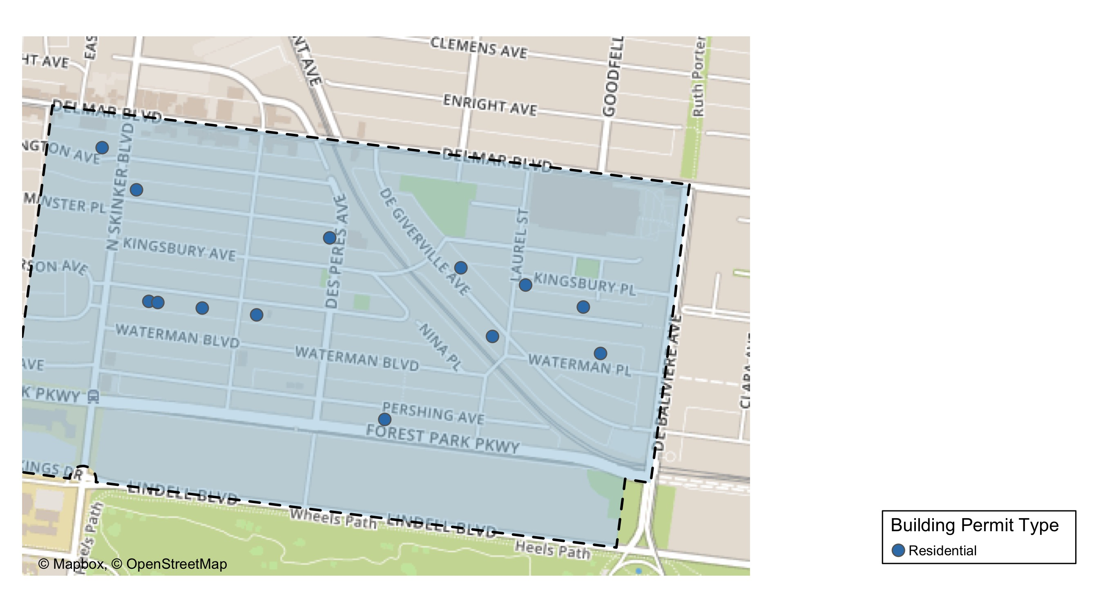
Skinker DeBaliviere

Slide 18
Neighborhood Summary
May 2021 | May 2021 | May 2021 | May 2021
Permit Use | Average Cost | # of Permits | Total Value of Permits
Commercial | $0 | 0 | $0
Industrial | $0 | 0 | $0
Institutional | $0 | 0 | $0
Residential | $18,202 | 13 | $236,627
Last 6 Months | Last 6 Months | Last 6 Months | Last 6 Months
Permit Use | Average Cost | # of Permits | Total Value of Permits
Commercial | $138,749 | 3 | $416,248
Industrial | $30,000 | 1 | $30,000
Institutional | $0 | 0 | $0
Residential | $29,682 | 45 | $1,335,694

Slide 19
Skinker DeBaliviere Individual Permit Breakdown
Owner | New Use | Cost | address
GRITZ, LIGAYA | Residential | $3,000 | 6168 MCPHERSON AV
THOMPSON, GREGG MICHAEL & | Residential | $35,000 | 6160 MCPHERSON AV
ONE WORLD USA LLC | Residential | $2,000 | 5912 PERSHING AV
DAVIDSON, LEONTINE G | Residential | $15,604 | 6054 MCPHERSON AV
SUMMERS, GREGINALD E & WANDA M | Residential | $14,669 | 6189 WESTMINSTER PL
HARSLEY, RACHEL E | Residential | $5,500 | 6006 WESTMINSTER PL
TOPPS, DOVIE M | Residential | $10,454 | 5747 WATERMAN BLVD
MENDICINO ENTERPRISES LLC | Residential | $25,000 | 6126 MCPHERSON AV
VAN BEURDEN, MARK & ASHLEY BRESSMER | Residential | $2,000 | 5855 DEGIVERVILLE AV
GLOBAL INVESTMENT GROUP LLC | Residential | $28,000 | 5765 MCPHERSON AV
ELOSIEBO, MECHELLE & | Residential | $80,000 | 5806 DEGIVERVILLE AV
HUGHES, BRIAN & LISA | Residential | $15,000 | 6215 WASHINGTON AV
WEISENSEE, PATRICIA B | Residential | $400 | 5786 KINGSBURY PL

Slide 20
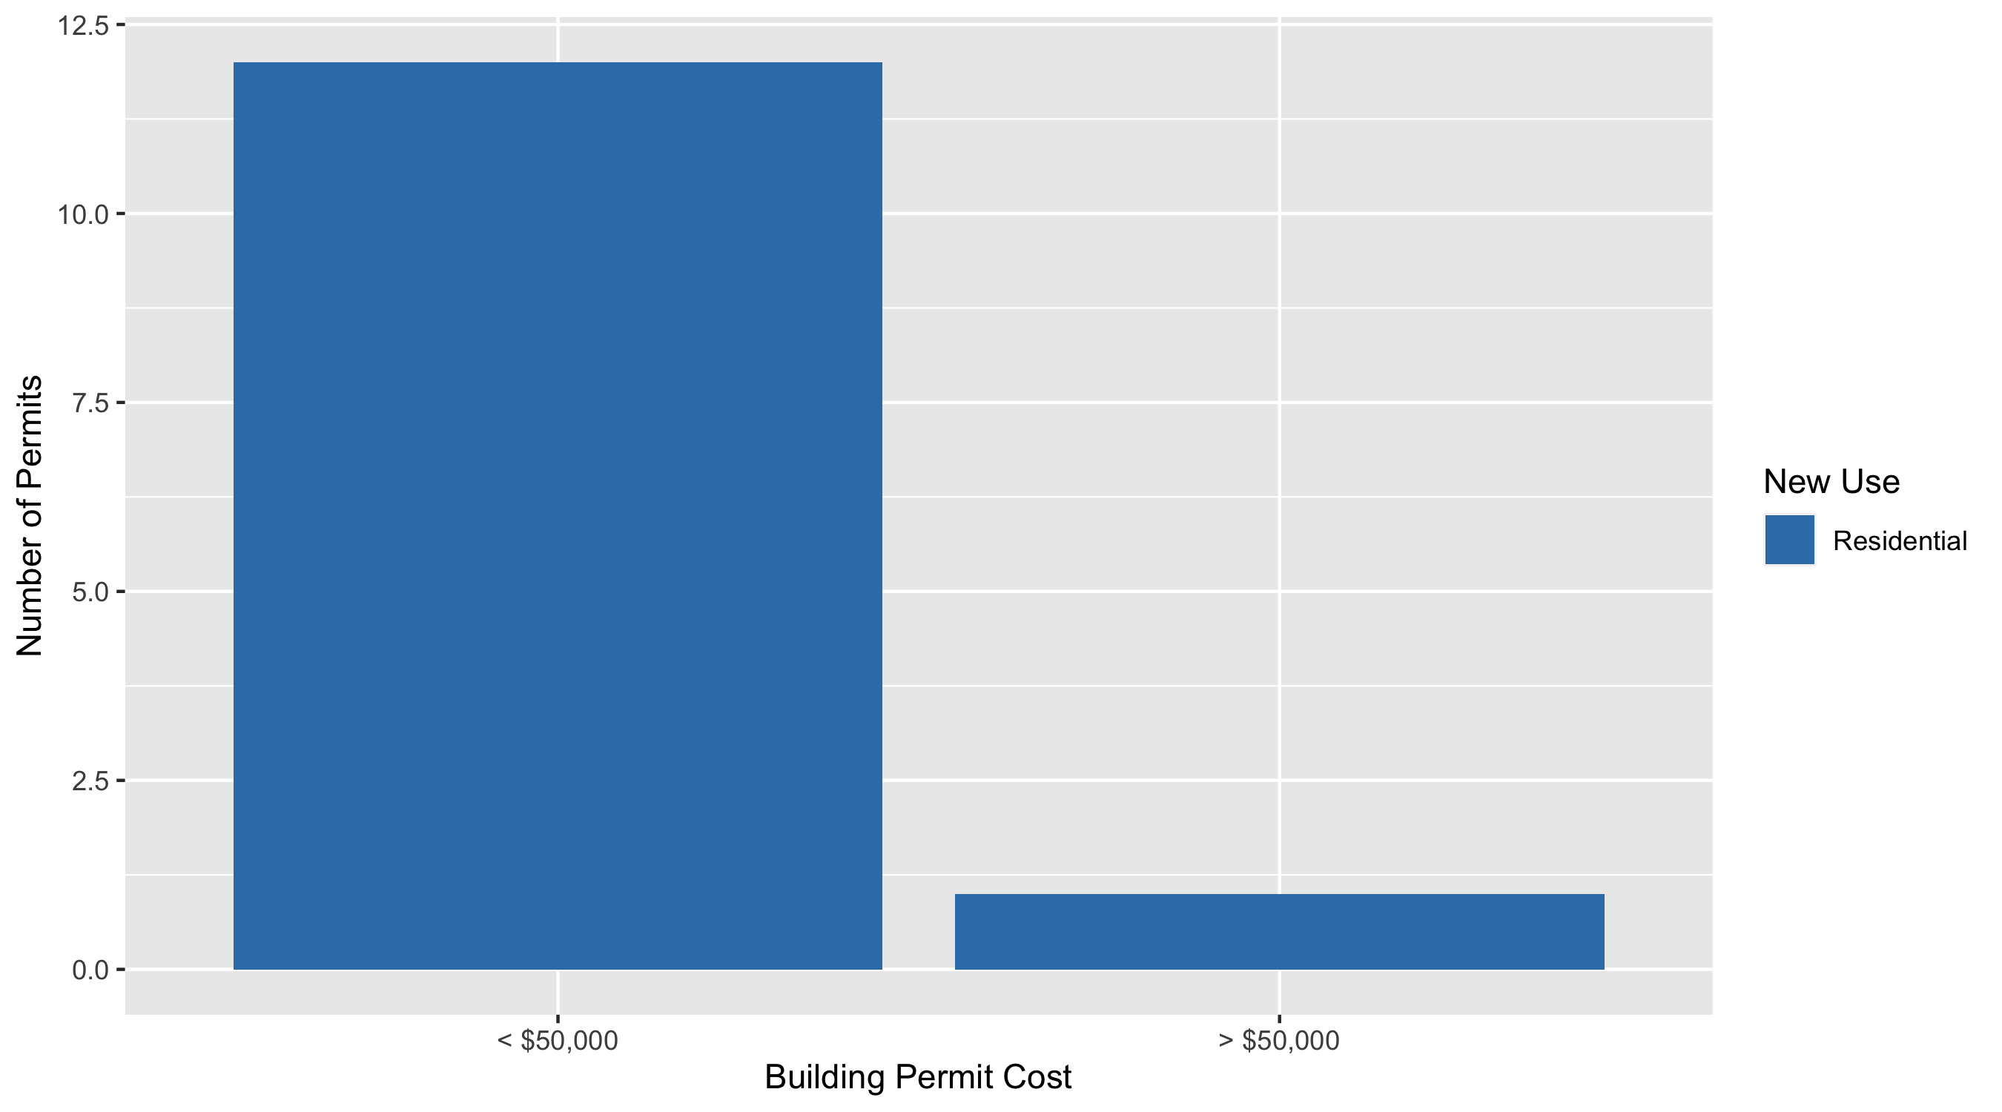
Skinker DeBaliviere Permit Cost Breakdown

Slide 21
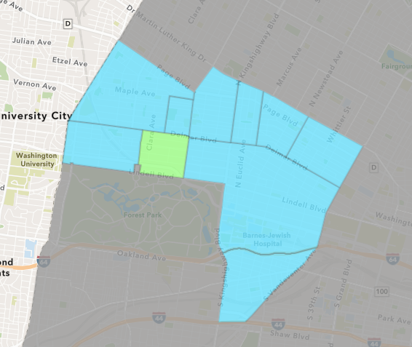
DeBaliviere Place
May 2021 Neighborhood Cost Breakdown
Mean: $95,845
Median: $59,210
Range: $35,000 - $275,000

Slide 22
DeBaliviere Place: Summary Notes
6 building permits in May 2021
100.00% change compared to May 2020 (3 total building permits)
$95,845: Average building permit cost in May 2021
-88.36% change compared to May 2020 ($823,223)
28 total building permits in 2021
154.55% change YTD compared to this time in 2020 (11 total building permits)
$75,691: YTD average building permit cost in 2021
-73.51% change YTD compared to this time in 2020 ($285,703)

Slide 23
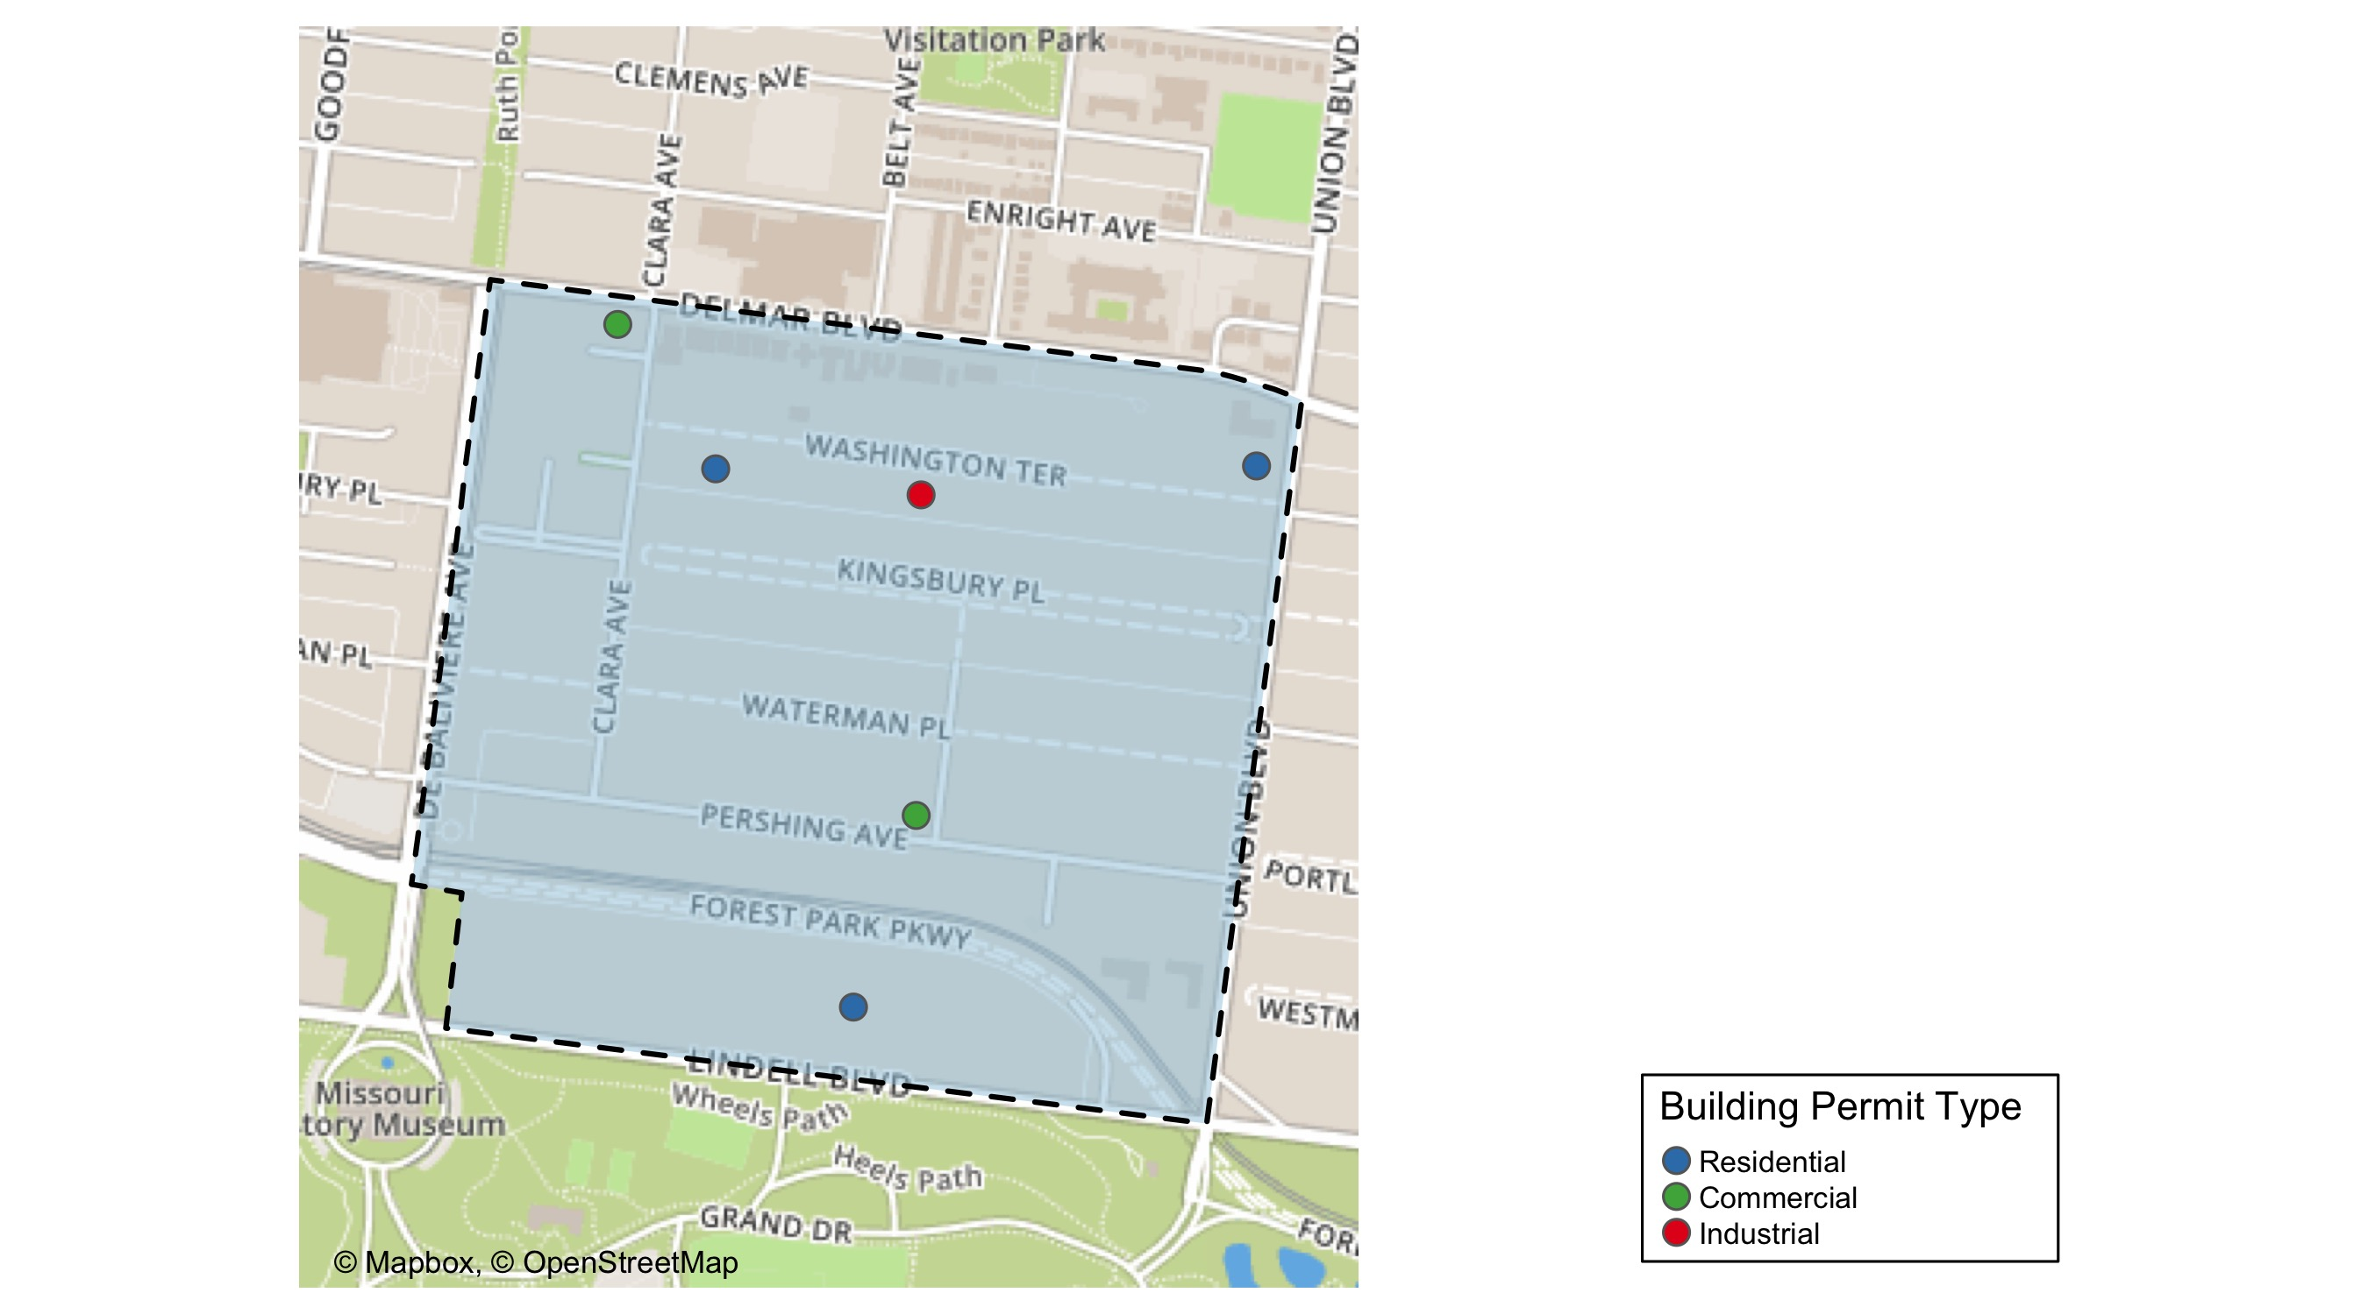
DeBaliviere Place

Slide 24
Neighborhood Summary
May 2021 | May 2021 | May 2021 | May 2021
Permit Use | Average Cost | # of Permits | Total Value of Permits
Commercial | $67,500 | 2 | $135,000
Industrial | $63,500 | 1 | $63,500
Institutional | $0 | 0 | $0
Residential | $125,523 | 3 | $376,569
Last 6 Months | Last 6 Months | Last 6 Months | Last 6 Months
Permit Use | Average Cost | # of Permits | Total Value of Permits
Commercial | $48,099 | 4 | $192,396
Industrial | $39,250 | 2 | $78,500
Institutional | $0 | 0 | $0
Residential | $342,232 | 29 | $9,924,716

Slide 25
DeBaliviere Place Individual Permit Breakdown
Owner | New Use | Cost | address
DEL-CLARA APARTMENTS LLC | Commercial | $35,000 | 5600 DELMAR BLVD
MINHAAT BOTNIM LLC | Commercial | $100,000 | 5513 PERSHING AV
KATIE ADASTRA & BARTHOLOMEW ADASTRA | Residential | $275,000 | 44 WASHINGTON TER
BURKER, TIMOTHY ROBERT & | Residential | $54,919 | 1 WASHINGTON TER
O'DELL, DALE A & JENNIFER TRS | Industrial | $63,500 | 30 WASHINGTON TER
KNESE, LEONARD H & SUSANNE J | Residential | $46,650 | 5505 LINDELL BLVD

Slide 26
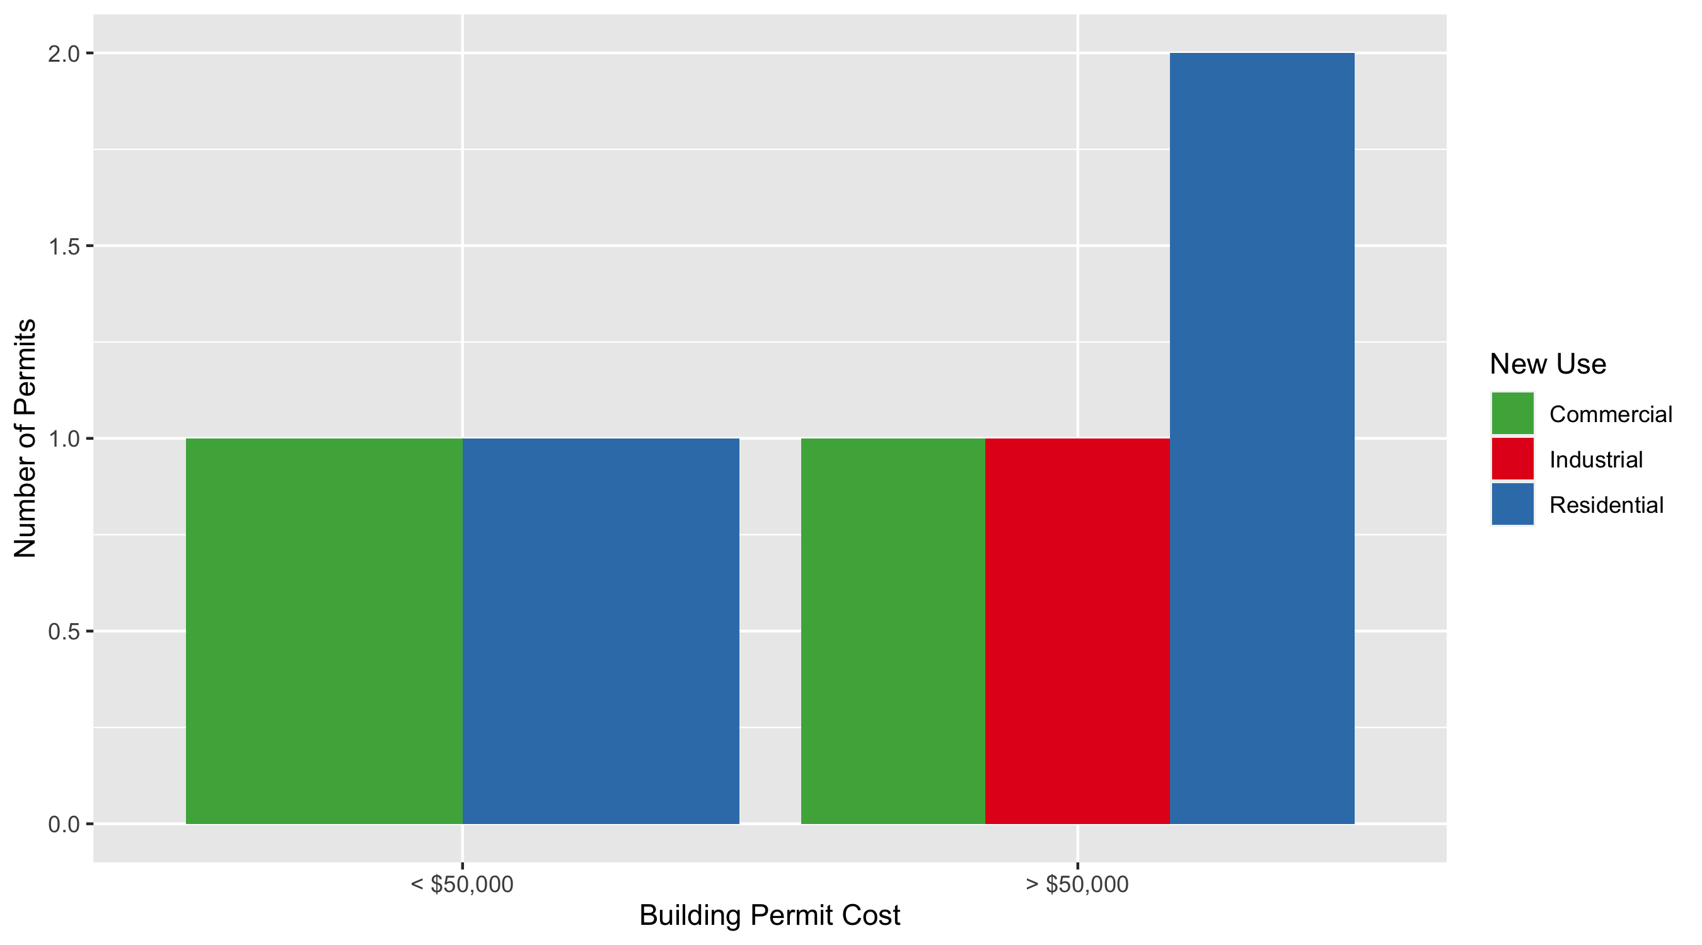
DeBaliviere Place Permit Cost Breakdown

Slide 27
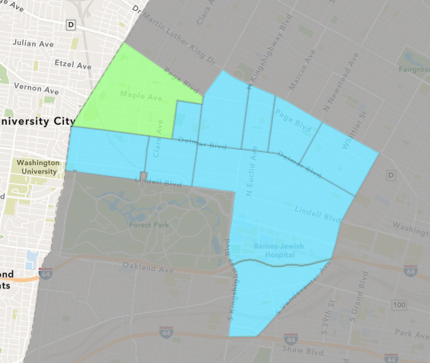
West End
May 2021 Neighborhood Cost Breakdown
Mean: $177,200
Median: $27,500
Range: $1,700 - $1,280,000

Slide 28
West End: Summary Notes
14 building permits in May 2021
366.67% change compared to May 2020 (3 total building permits)
$177,200: Average building permit cost in May 2021
950.59% change compared to May 2020 ($16,867)
43 total building permits in 2021
16.22% change YTD compared to this time in 2020 (37 total building permits)
$139,911: YTD average building permit cost in 2021
-15.43% change YTD compared to this time in 2020 ($165,431)

Slide 29
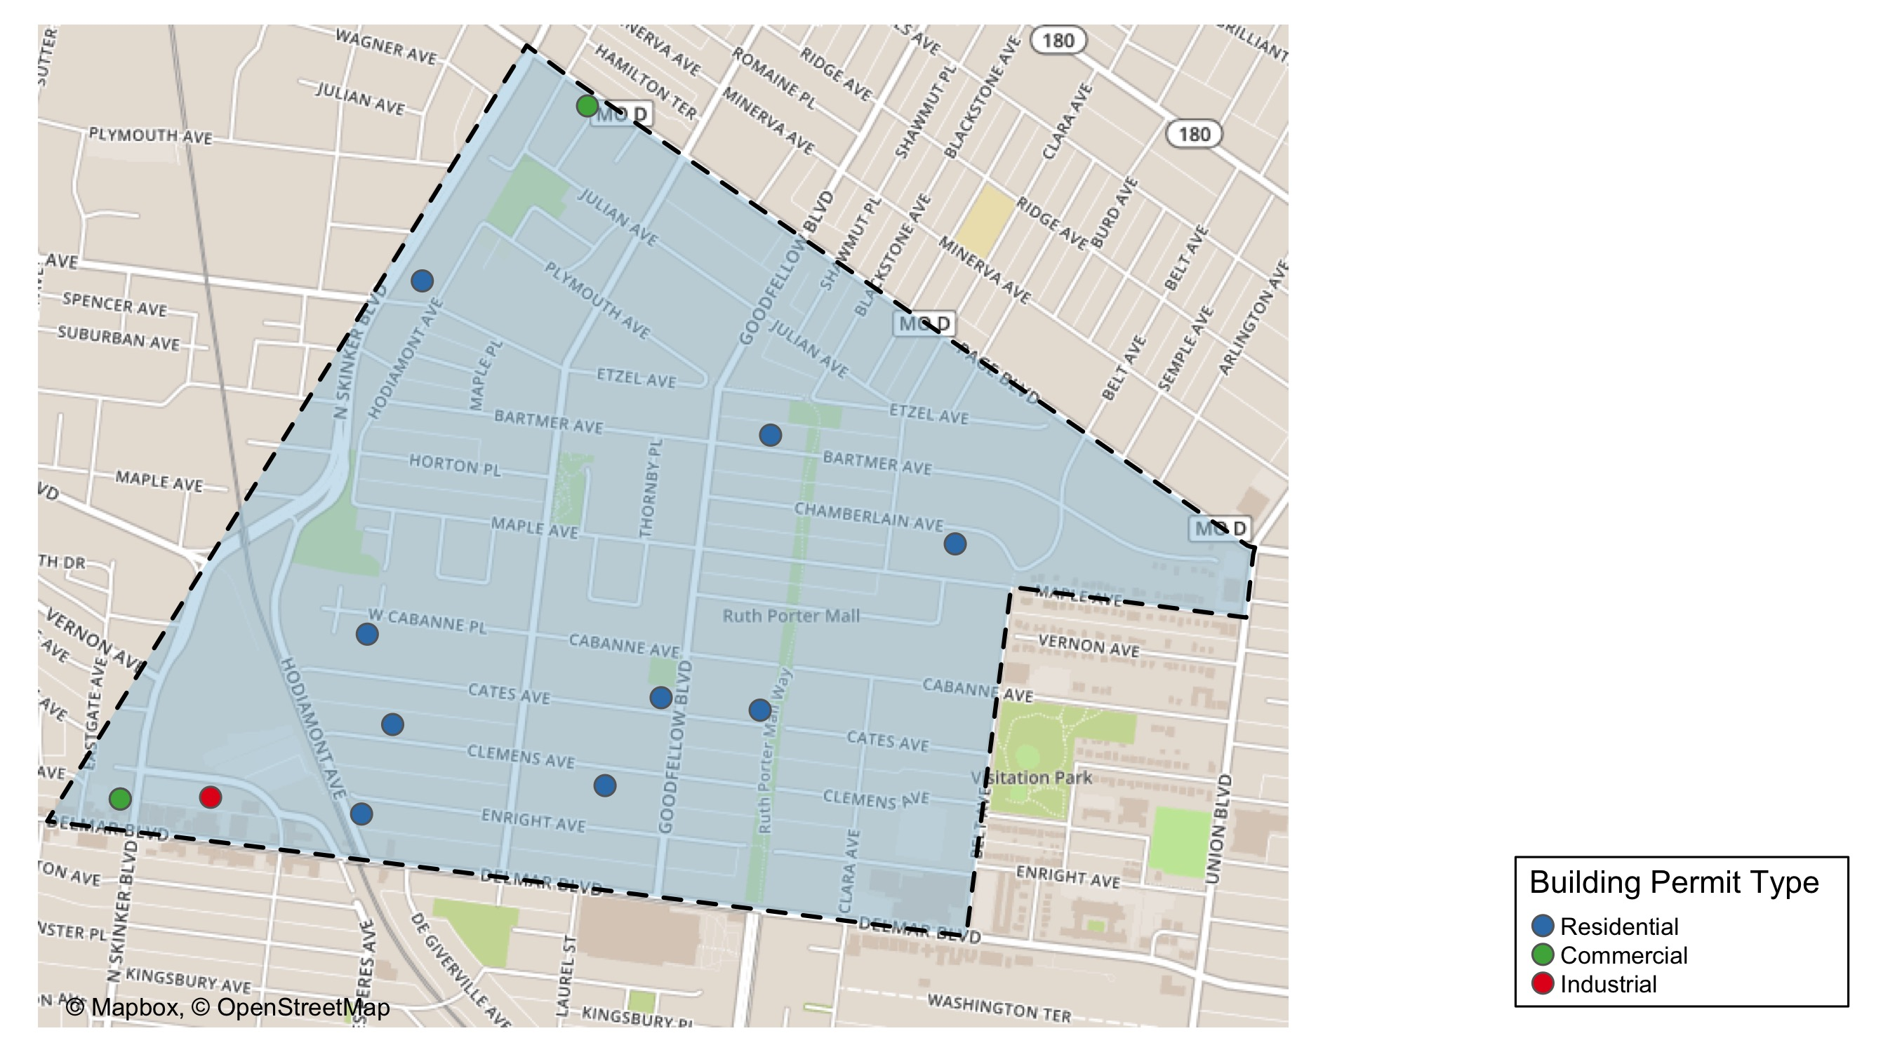
West End

Slide 30
Neighborhood Summary
May 2021 | May 2021 | May 2021 | May 2021
Permit Use | Average Cost | # of Permits | Total Value of Permits
Commercial | $2,333 | 3 | $7,000
Industrial | $15,000 | 1 | $15,000
Institutional | $0 | 0 | $0
Residential | $245,880 | 10 | $2,458,795
Last 6 Months | Last 6 Months | Last 6 Months | Last 6 Months
Permit Use | Average Cost | # of Permits | Total Value of Permits
Commercial | $179,022 | 7 | $1,253,156
Industrial | $18,372 | 6 | $110,230
Institutional | $0 | 0 | $0
Residential | $396,045 | 41 | $16,237,851

Slide 31
West End Individual Permit Breakdown
Owner | New Use | Cost | address
NEIGHBORHOOD PROPERTIES LLC | Residential | $800,000 | 5815 CATES AV
BECKEMEYER, BRETT & | Residential | $60,000 | 6040 WEST CABANNE PL
NGUYEN, DOUG | Residential | $120,000 | 5842 CLEMENS AV
DELMAR DEVINE MASTER LANDLORD COMMERCIAL | Residential | $61,901 | 5535 DELMAR BLVD
PAGEANT BUILDING LLC | Industrial | $15,000 | 6100 ENRIGHT AV
SMITH, LARRY EDWARD JR & TONNIE J | Residential | $11,194 | 6011 CLEMENS AV
WEBB, CARTELIA | Residential | $1,700 | 5560 CHAMBERLAIN AV
ALPHA TERRACE APARTMENTS LP | Residential | $1,280,000 | 6105 ETZEL AV
PACE-DELMAR ASSOCIATES LLC | Commercial | $2,500 | 621 N SKINKER BLVD
PACE-DELMAR ASSOCIATES LLC | Commercial | $2,800 | 6217 DELMAR BLVD
FAVORED FOUNDATION FOR | Commercial | $1,700 | 1297 AMHERST PL
CARADINE, LAVELL | Residential | $14,000 | 5727 BARTMER AV
DELOSPHERE HOLDINGS LLC | Residential | $70,000 | 5673 CATES AV
SADDLER, LATERRYL | Residential | $40,000 | 730 HODIAMONT AV

Slide 32
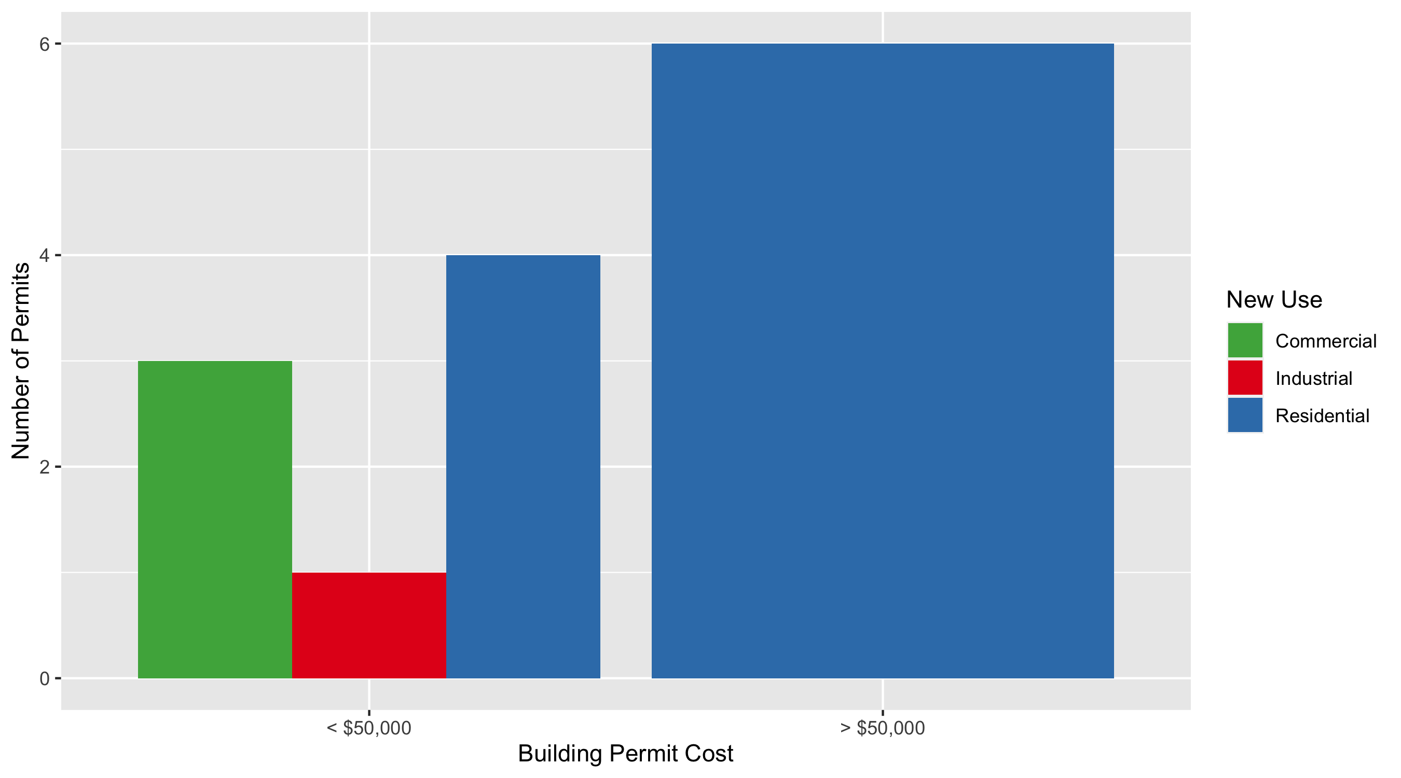
West End Permit Cost Breakdown

Slide 33
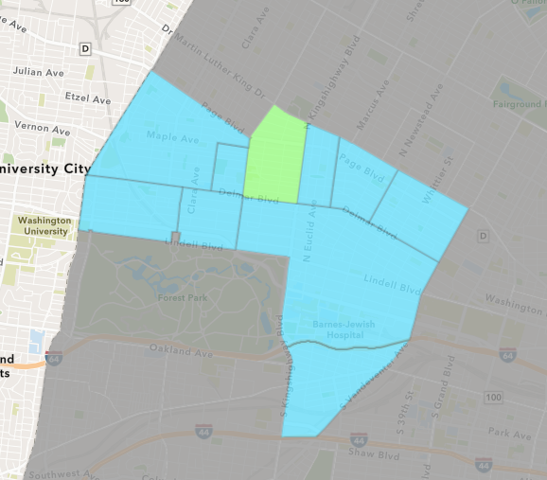
Academy
May 2021 Neighborhood Cost Breakdown
Mean: $31,475
Median: $31,475
Range: $23,000 - $39,950

Slide 34
Academy: Summary Notes
2 building permits in May 2021
0.00% change compared to May 2020 (2 total building permits)
$31,475: Average building permit cost in May 2021
-58.91% change compared to May 2020 ($76,600)
10 total building permits in 2021
-23.08% change YTD compared to this time in 2020 (13 total building permits)
$73,550: YTD average building permit cost in 2021
-9.21% change YTD compared to this time in 2020 ($81,012)

Slide 35
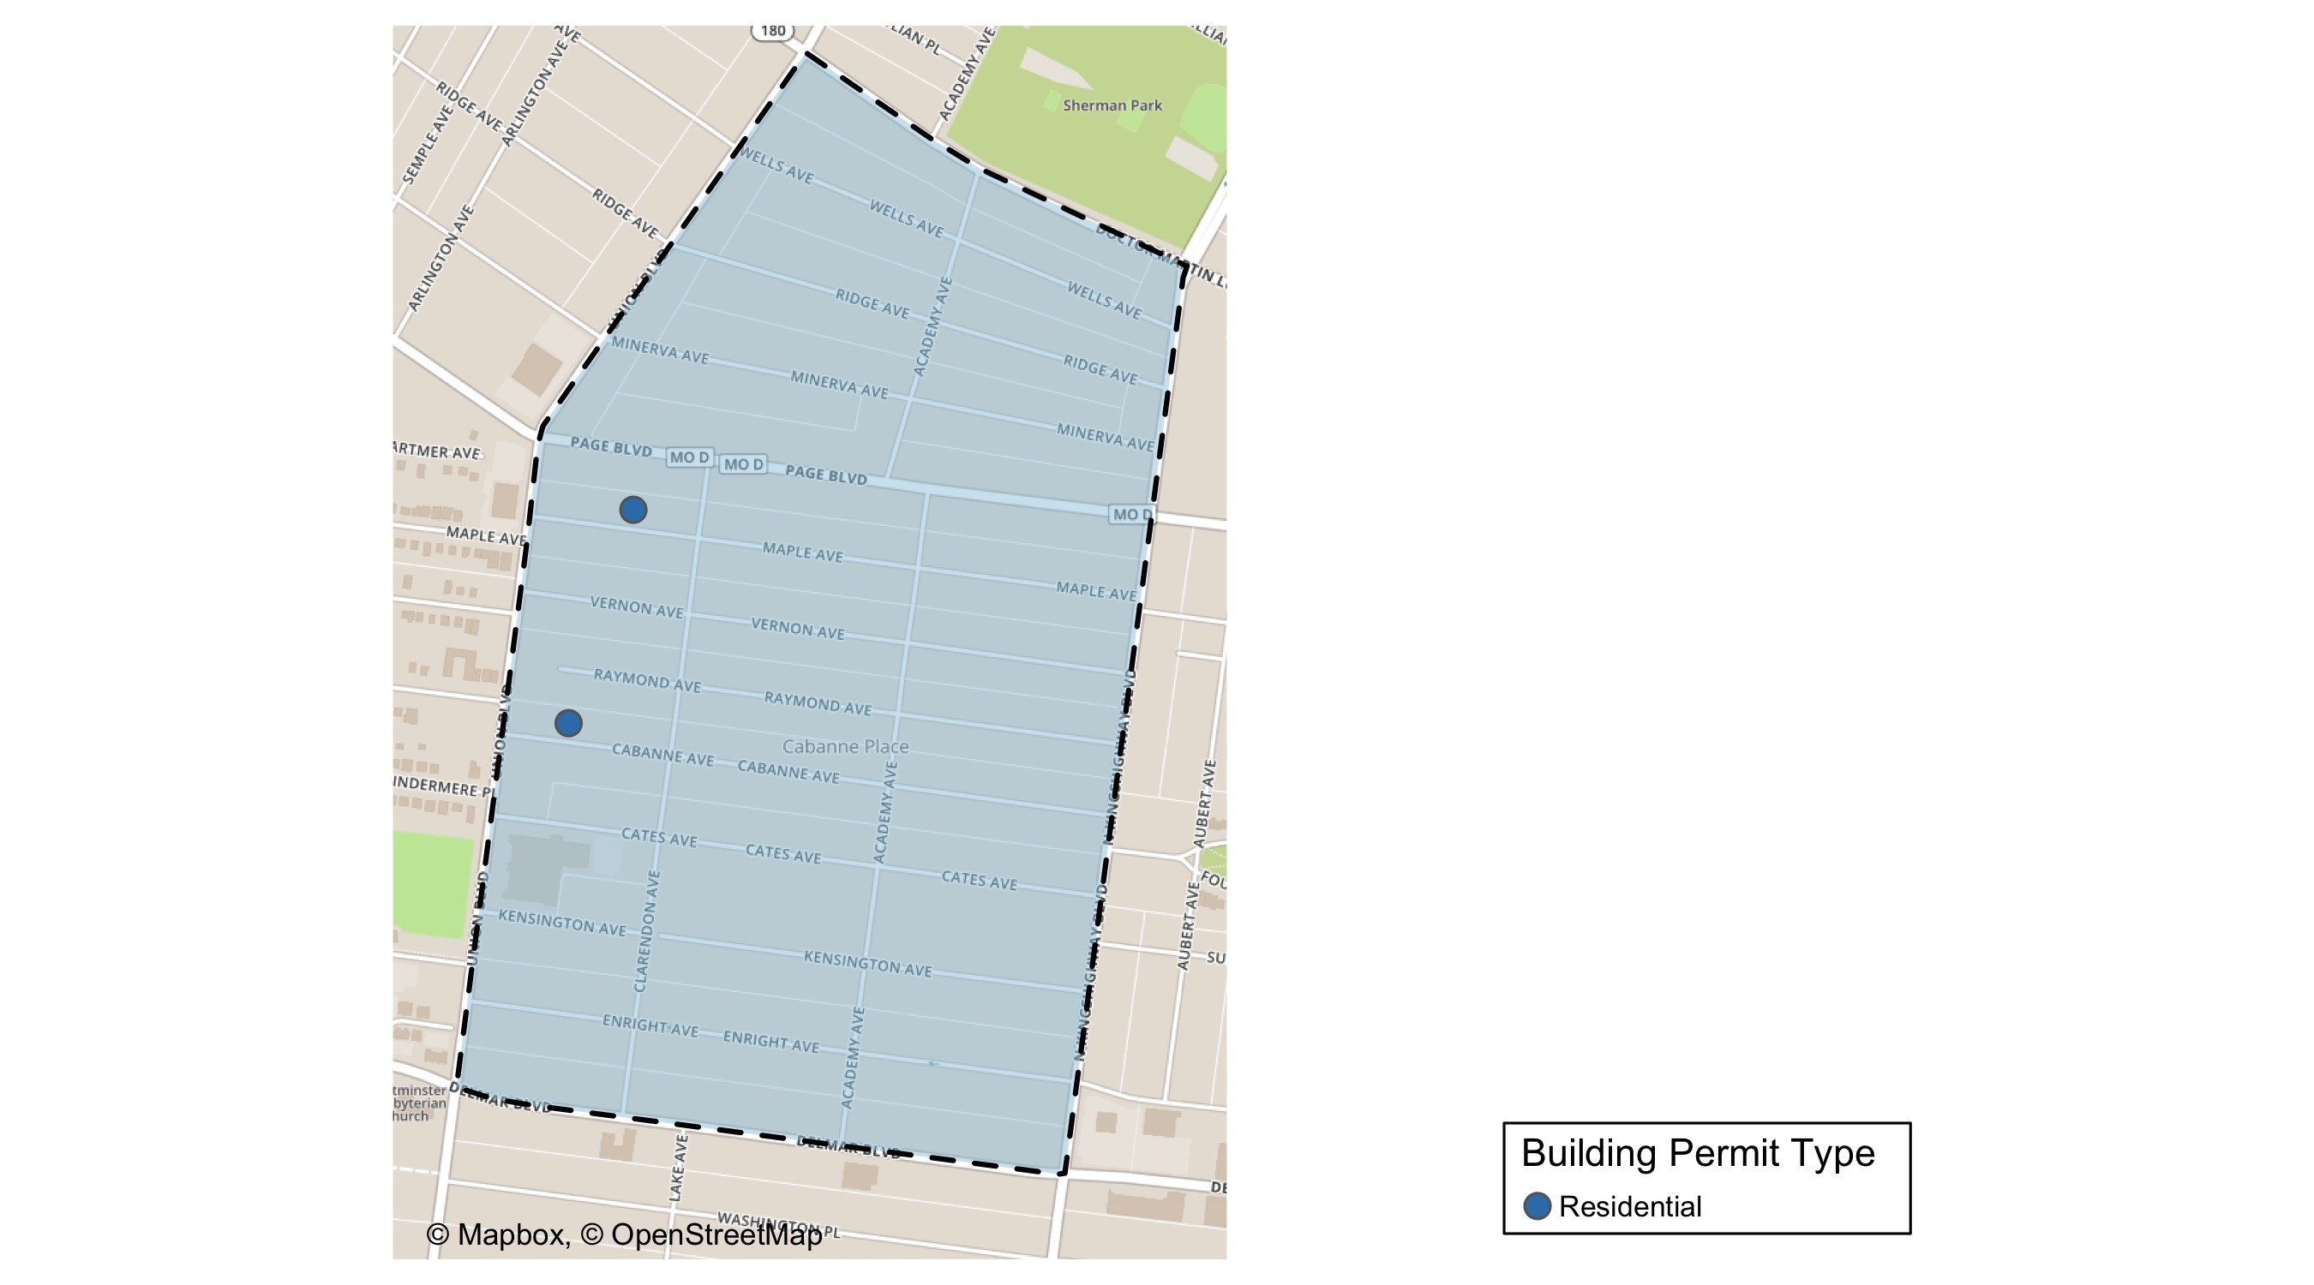
Academy

Slide 36
Neighborhood Summary
May 2021 | May 2021 | May 2021 | May 2021
Permit Use | Average Cost | # of Permits | Total Value of Permits
Commercial | $0 | 0 | $0
Industrial | $0 | 0 | $0
Institutional | $0 | 0 | $0
Residential | $31,475 | 2 | $62,950
Last 6 Months | Last 6 Months | Last 6 Months | Last 6 Months
Permit Use | Average Cost | # of Permits | Total Value of Permits
Commercial | $10,250 | 2 | $20,500
Industrial | $500 | 1 | $500
Institutional | $0 | 0 | $0
Residential | $69,098 | 13 | $898,275

Slide 37
Academy Individual Permit Breakdown
Owner | New Use | Cost | address
HENDRICKS, STACY | Residential | $23,000 | 5247 CABANNE AV
COGSHELL, GWENDOLYN | Residential | $39,950 | 5229 MAPLE AV

Slide 38
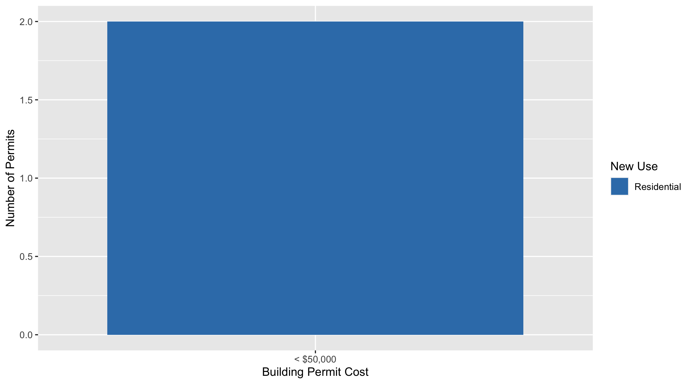
Academy Permit Cost Breakdown

Slide 39
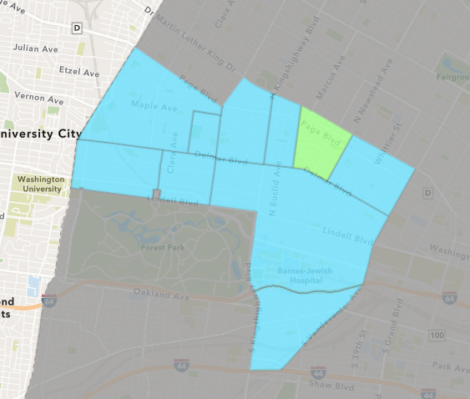
Lewis Place
May 2021 Neighborhood Cost Breakdown
Mean: $37,143
Median: $37,143
Range: $37,143 - $37,143

Slide 40
Lewis Place: Summary Notes
1 building permits in May 2021
-66.67% change compared to May 2020 (3 total building permits)
$37,143: Average building permit cost in May 2021
15818.43% change compared to May 2020 ($233)
8 total building permits in 2021
100.00% change YTD compared to this time in 2020 (4 total building permits)
$13,008: YTD average building permit cost in 2021
1526.03% change YTD compared to this time in 2020 ($800)

Slide 41
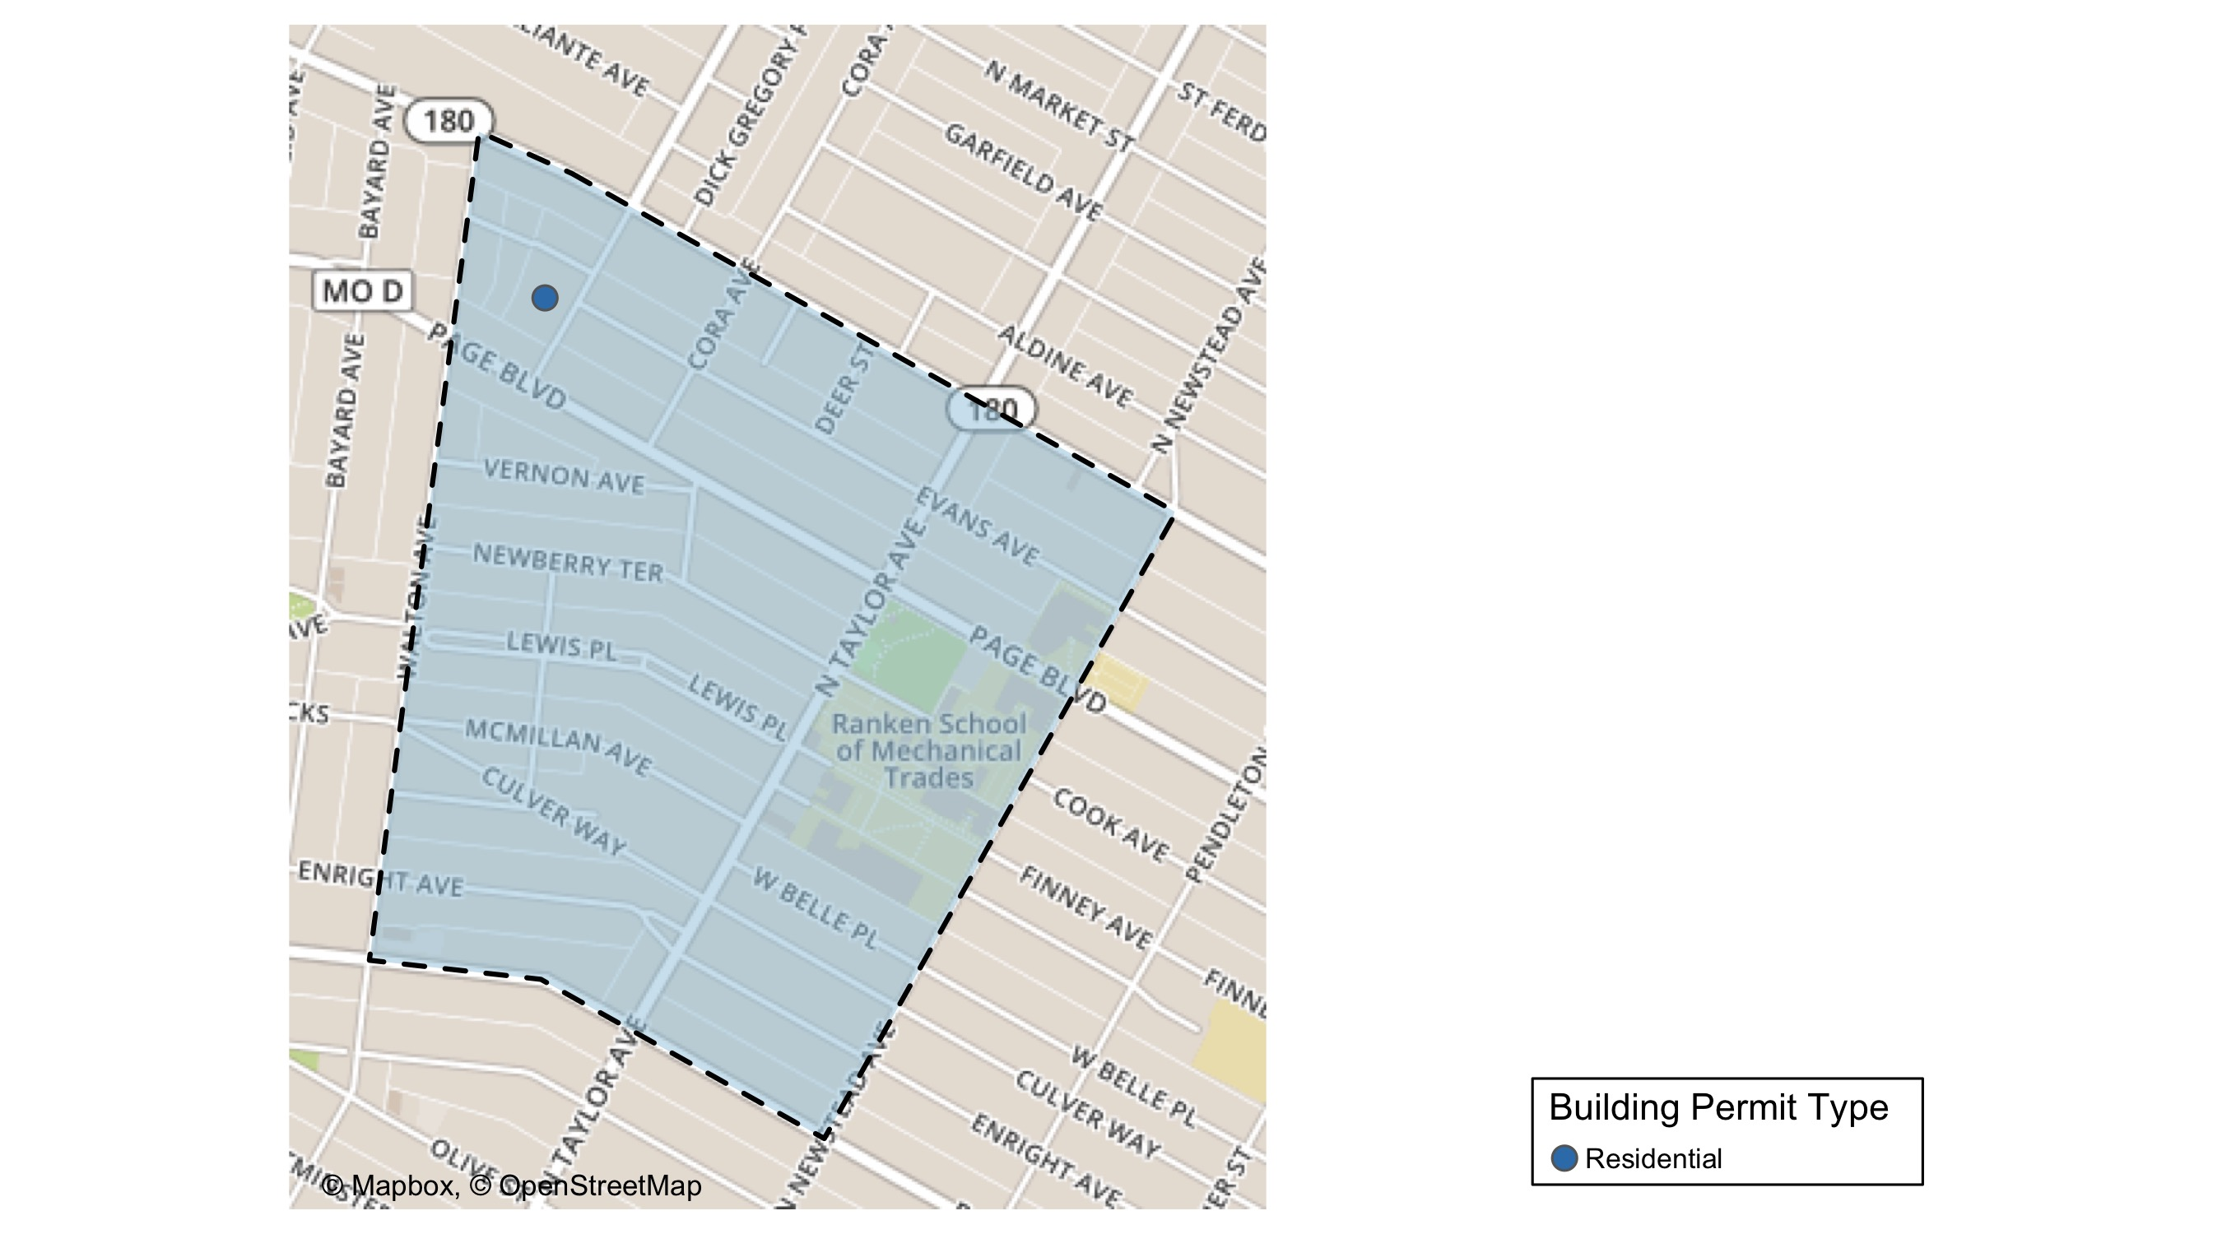
Lewis Place

Slide 42
Neighborhood Summary
May 2021 | May 2021 | May 2021 | May 2021
Permit Use | Average Cost | # of Permits | Total Value of Permits
Commercial | $0 | 0 | $0
Industrial | $0 | 0 | $0
Institutional | $0 | 0 | $0
Residential | $37,143 | 1 | $37,143
Last 6 Months | Last 6 Months | Last 6 Months | Last 6 Months
Permit Use | Average Cost | # of Permits | Total Value of Permits
Commercial | $0 | 0 | $0
Industrial | $0 | 0 | $0
Institutional | $0 | 0 | $0
Residential | $12,521 | 10 | $125,206

Slide 43
Lewis Place Individual Permit Breakdown
Owner | New Use | Cost | address
TORRENCE, SENA | Residential | $37,143 | 1329 MARCUS AV

Slide 44
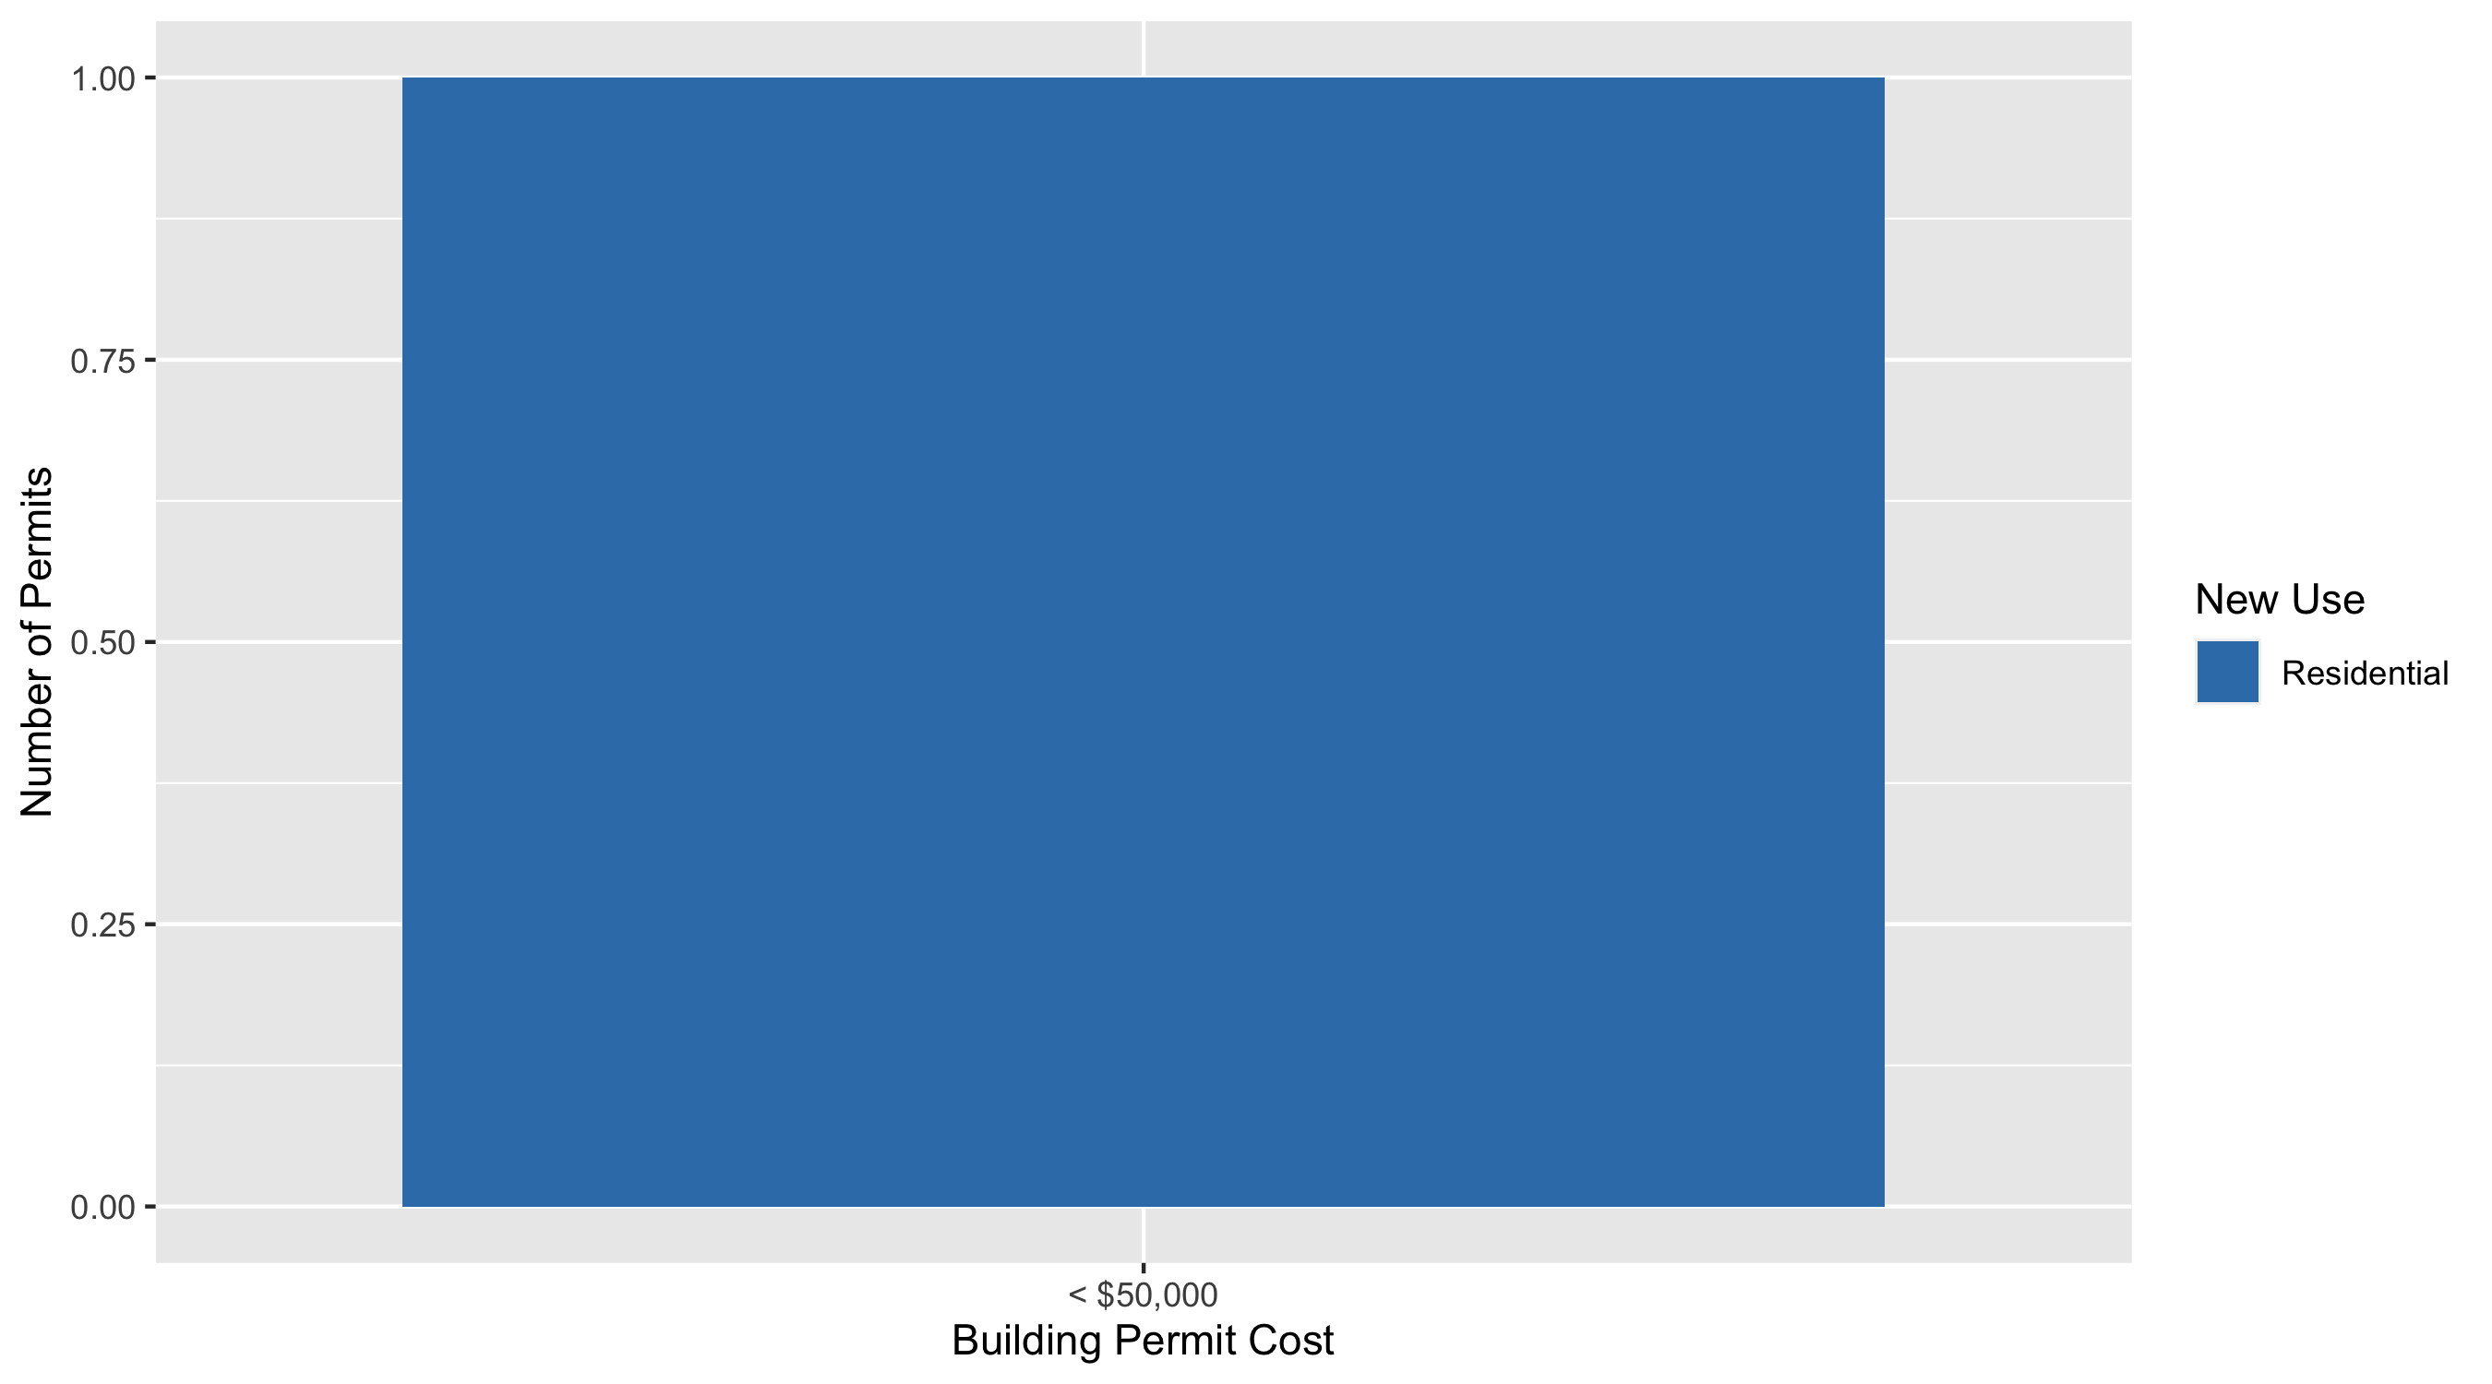
Lewis Place Permit Cost Breakdown

Slide 45
Additional Notes
Data retreived from https://www.stlouis-mo.gov/data/
Building permits with a cost of $0 were dropped
Building permits that were cancelled were dropped
Infinite change indicates 0 permits in the current or previous time period/comparison month so there was a overall increase or decrease

